Slide 1
UNIT-IV PART-IV
COMPaS: A Pentium Pro PC-Based SMP Cluster
By
Dr. K. Shahu Chatrapati
Professor & Controller of Examinations

Slide 2
Contents
1. Introduction
2. Configuration of COMPaS
3. NICAM
3.1 NICAM: User-Level Communication Layer
3.2 NICAM Design
3.3 NICAM Primitives
3.4 Remote Memory Operations
3.5 NICAM Barrier Mechanism
3.6 Performance Analysis

Slide 3
1. Introduction
SMPs(symmetric multiprocessor) are used for high-performance parallel computing.
Provide shared memory for inter-processor communication.
Higher bandwidth compared to network communication.
COMPaS: A cluster of SMPs built using Pentium Pro PCs.

Slide 4
COMPaS stands for Cluster Of Multi-Processor Systems.
It is a cluster of eight nodes, each of which is a quad-processor Pentium Pro PC.
COMPaS is a PC-based SMP cluster.
The Pentium Pro is a microprocessor developed by Intel in 1995. It was the sixth-generation x86 microprocessor.

Slide 5
Clusters of SMP PCs are considered the supercomputers of tomorrow because they are comparable to the performance of massively parallel processors.
Clusters of PCs with commodity networking are attractive platforms for high-end scientific computing.
The COMPaS cluster has a remote memory based user-level communication layer that provides low-overhead and high bandwidth using Myrinet.

Slide 6
2. Configuration of COMPaS
It Consists of 8 quad-processor Pentium Pro PC servers.
Toshiba GS700 with 450GX chip-set.
Connected by Myrinet and 100Base-T Ethernet.
Operating system: Solaris with MPICH for communication.

Slide 7
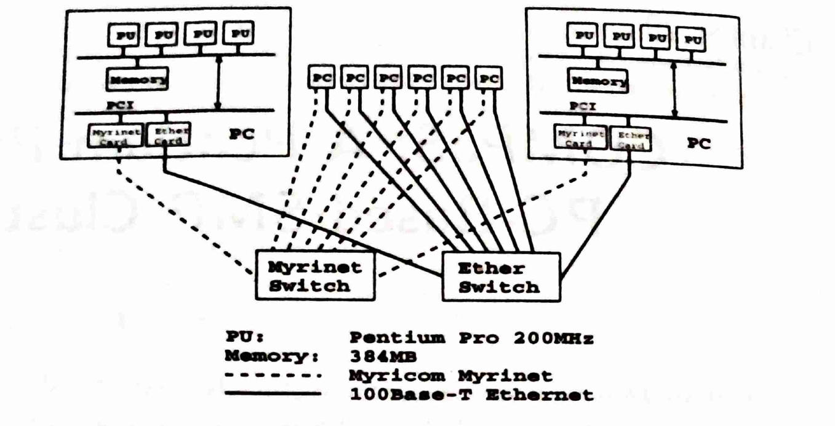
Fig. Configuration of COMPaS

Slide 8
We have discussed about
1. Introduction to SMPs
2. Configuration of COMPaS

Slide 9
3. NICAM
NICAM(Network Interface Communication layer using Active Messages).
NICAM provides considerably higher performance than MPICH on 100Base-T Ethernet.

Slide 10
3.1 NICAM: User-Level Communication Layerof Myrinet for SMP Cluster
Provides high-bandwidth, low-overhead memory transfers.
Uses remote memory operations instead of message passing.
Avoids mutual exclusion and memory bandwidth issues.
Implemented on Myrinet for efficient communication.

Slide 11
3.2 NICAM Design
Reduces processor involvement using NI (Network Interface).
Remote memory operations over message passing.
Uses synchronization primitives for efficiency.
Implements a user-level communication layer on Myrinet.

Slide 12
3.3 NICAM Primitives
Initialization:
- nicam_init(), nicam_lock_memory()
Data Transfer:
- nicam_bcopy(), nicam_sync()
Synchronization:
- nicam_bcopy_notify(), nicam_set_counter()
Barrier & Broadcast:
- nicam_barrier(), nicam_bcast()

Slide 13
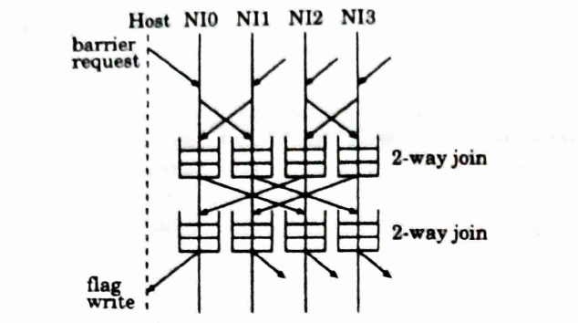
Fig. Steps of the multi-stage barrier performed between NIs.
Each 2-way join has a small queue to accommodate multiply issued barrier.

Slide 14
3.4 Remote Memory Operations
Acts like a remote read operation.
Uses Active Messages to forward requests.
nicam_sync ensures completion of copies.
NICAM minimizes data transfer corruption risks.

Slide 15
3.5 NICAM Barrier Mechanism
Uses multi-stage Log(P) step algorithm.
Avoids host processor polling.
Implements relaxed barriers for concurrency.
Operates entirely on the NI for efficiency.

Slide 16
3.6 Performance Analysis
Bandwidth: ~105MB/s for 64K byte transfers.
Latency: ~20.7µsec for small messages.
NICAM is more efficient as node count increases.
Call overhead of nicam_bcopy is ~5.7µsec.

Slide 17
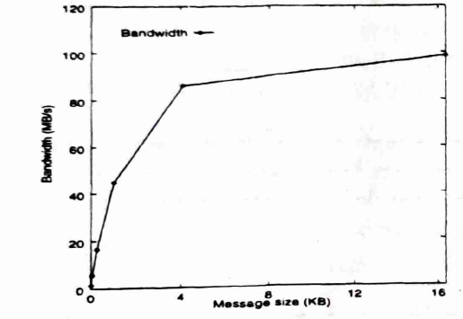
Fig. Bandwidth (throughput) of NICAM.

Slide 18
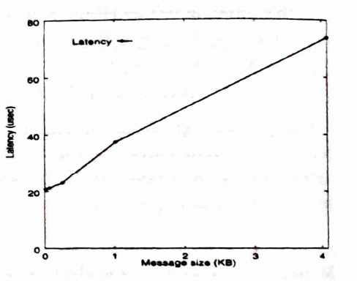
Fig. Latency of NICAM.

Slide 19
We have discussed about
NICAM
NICAM: User-Level Communication Layer
NICAM Design
NICAM Primitives
Remote Memory Operations
NICAM Barrier Mechanism
Performance Analysis

Slide 20
Conclusion
COMPaS utilizes SMP clusters for parallel computing.
NICAM enhances communication with remote memory transfers.
Uses Myrinet and Active Messages for efficiency.
Provides scalable and high-performance clustering solutions.

